Slide 1
SCSA SC2001 Lab
Example Class
Project 2 Team 7
PU FANYI (U2220175K)
PUSHPARAJAN ROSHINI (U2222546A)
QIAN JIANHENG OSCAR (U2220109K)
RHEA SUSAN GEORGE (U2220116B)

Slide 2
Part A:
Using array for priority queue
Using Adjacency Matrix

Slide 3
Implementation of Dijkstra’s algorithm
distances[0] = 0;
for (int i = 1; i < numVertices; ++i) {
int min = INT_MAX;
int min_index = -1;
for (int j = 0; j < numVertices; ++j) {
++(*compare_count);
if (!visited[j] && distances[j] < min) {
min = distances[j];
min_index = j;
}
}
if (min == INT_MAX) break;
visited[min_index] = 1;
for (int j = 0; j < numVertices; ++j) {
if (!visited[j] && (++(*compare_count)) &&
adjMatrix->adjMatrix[min_index][j] != INT_MAX &&
(distances[j] == INT_MAX ||
distances[min_index] + adjMatrix->adjMatrix[min_index][j] < distances[j])) {
distances[j] = distances[min_index] + adjMatrix->adjMatrix[min_index][j];
}
}
}
Notes:
This is the code for the main part of the algorithm for our implementation of dijkstra. It is similar to the one show in the lecture, so we won't elaborate on it.

Slide 4
Theoretical Analysis
The Dijkstra algorithm time complexity is O(V²), where V is the graph's vertex count.
The following is an explanation:
Finding the unvisited vertex with the shortest path. This requires O(V) time.
We now need to relax the neighbours of each vertex chosen. Every relaxation time complexity is O(1).
We need to relax every vertex's neighbours, it takes [O(V) * O(1)] = O(V) time to update every vertex's neighbours.
Processing one vertex in O(V) seconds
O(V)*O(V) = O(V²) is the time required to visit and process all of the vertices.
Notes:
The Dijkstra algorithm’s time complexity is O(V2), where V is the graph's vertex count.
Finding the unvisited vertex with the shortest path is the first thing we must perform. Since we must check each vertices, this requires O(V) time.
We now need to relax the neighbours of each vertex chosen as above, which entails updating each neighbour's path to the smaller value between its present path and the newly discovered. The time needed to unwind one neighbour is of the order of O(1) (constant time).
We need to relax every vertex's neighbours, and since each vertex can only have V-1 neighbours, it takes [O(V) * O(1)] = O(V) time to update every vertex's neighbours
As a result of the above circumstances, we get:
Time required to visit each vertex = O (V)
Processing one vertex in O(V) seconds
O(V)*O(V) = O(V^2) is the time required to visit and process all of the vertices.
Dijkstra's algorithm, which represents adjacency matrices, has a time complexity of O(V2). Because a V*V matrix is needed to hold the representation of the graph,

Slide 5
Empirical Analysis: Fixed |E|, Vary |V|
Our approach:
Generate random graphs with the following settings
Fixed |E| = 10,000 and Starting |V| = 100 , until 5,000
Step = 100
Each step, the algo is ran 100 times with a newly generated graph.
Average key comparison is then taken

Slide 6
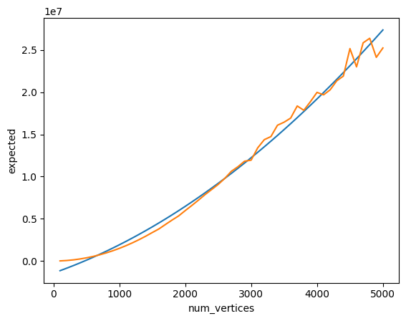
Empirical Analysis
Fixed Edges, Vary Vertices
T(|V|, |E|) = k₁ * |V|² + k₂ * |V|
k₁ = 6.03343824e-01
k₂ = 2.74286781e+03
Notes:
To prove that our theoretical time complexity O(|V|^2) is accurate, we did regression on our empirical result and obtained a fitting line. With k1=0.603 and k2=2742.86, signifying that it is indeed O(|V|^2)
Deviation is due to the key comparisons not counted for when popping. Using polynomial regression, we were able to plot accordingly. K1 and K2 are the weights

Slide 7
Empirical Analysis: Fixed |V|, Vary |E|
Our approach:
Generate random graphs with the following settings
Fixed |V| = 1000 and Starting |E| = 10,000 , until 1,000,000
Step = 10,000
Each step, the algo is ran 10 times with a newly generated graph.
Average key comparison is then taken

Slide 8
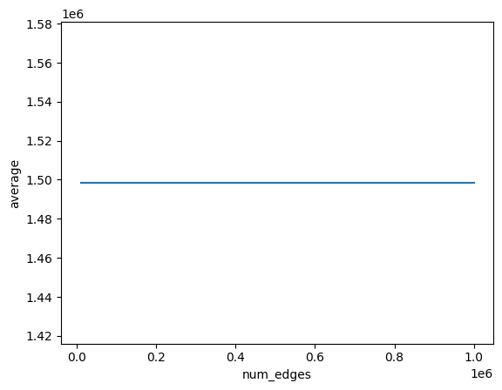
Empirical Analysis
Fixed Vertices Vary Edges
T(|V|, |E|) = O(|V|²)
Notes:
O(|V|^2) so adjusting E does not change the comparisons

Slide 9
Part B:
Using Minimising Heap for priority queue
Using Adjacency List

Slide 10
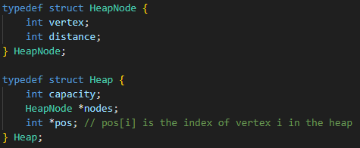
Implementation
Notes:
For implementation, this is our implementation of the heap, where each heap node have the vertex and distance. We keep track of the index of the vertex with another array pos in the Heap structure.

Slide 11
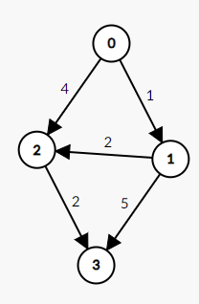
Example
Source node initialised with distance=0
Graph
[index,distance]
[0,0]
Create a minimising heap and initialise with source vertex - distance to be 0, other vertices : infinity
While minimum heap is not empty, pop the root vertex with minimum distance/highest priority
For each adjacent vertex of popped vertex, calculate the new distance by adding the weight of edge between the 2 vertices
If new distance is < current, update the distance array
And update the heap
Repeat until all vertices are popped or destination vertex attained
Obtain shortest distances of vertices from distance d array
[2,3]
[1,1]
3
1
4
infinity
infinity
All other node initially initialised to infinity (integer max)

Slide 12
Theoretical Analysis
2 Key factors which affect time complexity:
Popping/Extracting the minimum element from the minimising heap
The operation to fix the heap after popping each vertex takes O(log |V|)
We do this for all V vertices so O(|V| log |V|)
Relaxation of outgoing edges
For V vertices, |E| : max number of times where distance can be adjusted
O (log |V|) : Swapping to fixheap
Combining both, O(|E| log |V|)
log|V|
…
…
…
…
O((|V| + |E|)log |V|)
Notes:
Now, there are 2 main operations in the algorithm which affects the time complexity.
First, is the the extraction of minimum node during every iteration. To fix heap, it takes O(log|V|) times as the depth is at most log|V|. And Since we do this for all Vertices, we get |V|log(|V|)
Second, is the update of weight after popping at every iteration. Similarly, after updating the heap nodes, the time complexity to fix the heap is log(|V|). And since we can update the weight at most |E| times, this gives |E| log(|V|)
Combining these 2 gives (V+E) O(logV)

Slide 13
Empirical Analysis: Fixed |E|, Vary |V|
Our approach:
Generate random graphs with the following settings
Fixed |E| = 200,000 and Starting |V| = 1000 , until 100,000
Step = 1000
Each step, the algo is ran 100 times with a newly generated graph.
Average key comparison is then taken

Slide 14
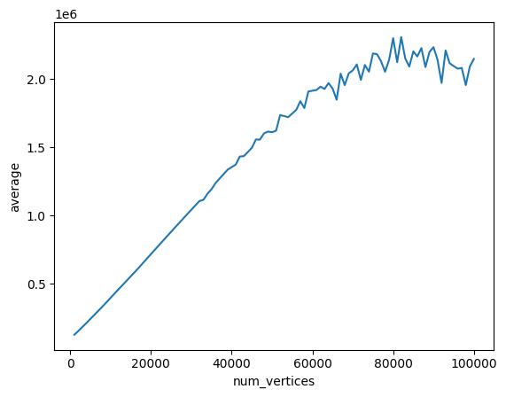
Empirical Analysis
Fixed Edges, Vary Vertices
As |E| gets nearer to |V|,
Since our graph are randomly generated, there are increasing chance of disconnected components appearing.
Resulting in lesser than expected key comparison in some case -> leading to fluctuations
Notes:
There are extra nodes/vertices which are not being involved in the D algorithm so thats not being accounted for -- disconnected so comparisons are less than expected

Slide 15
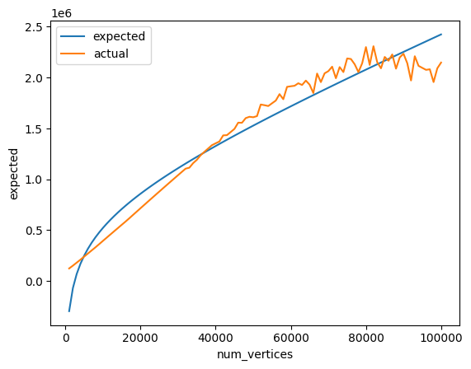
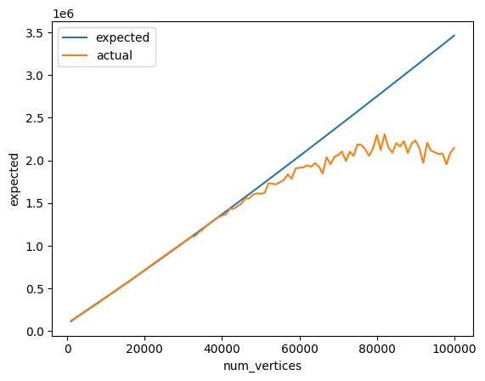
Compare Theoretical and Empirical
T(|V|, |E|) = k₁ * |V| log |V| + k₂ * |E| log |V|
Regression on the whole range
k₁ = 0.770432, k₂ = 1.08882654
Regression on |V| < 40000
k₁ = 1.98047116, k₂ = 0.05876973
Notes:
From our theoretical analysis, we know that time complexity is O((V+E) log (|V|)).
To find the specific equation for time complexity based on our empirical result, we decided to use linear regression to compute the constants, k1 and k2.
We initially did the regression on the whole range, but the result is not satisfactory, the reason is explained on the previous slide, as |V| gets close to |E|, the result is not accurate since there is more likely chance to have disconnected components in the graph.
Then, we did linear regression on range of |V| less than 40,000. And was able to get a satisfactory line. With a k1=1.98, k2=0.058. We can see that k2 is very small, this shows that in actual case, the chance of updating the distance at each iteration is very low for a random graph

Slide 16
Empirical Analysis: Fixed |V|, Vary |E|
Our approach:
Generate random graphs with the following settings
Fixed |V| = 10,000 and Starting |E| = 10,000 , until 1,000,000
Step = 10,000
Each step, the algo is ran 10 times with a newly generated graph.
Average key comparison is then taken
Notes:
Next we are looking at empirical analysis for fixed |V| and Vary |E|.

Slide 17
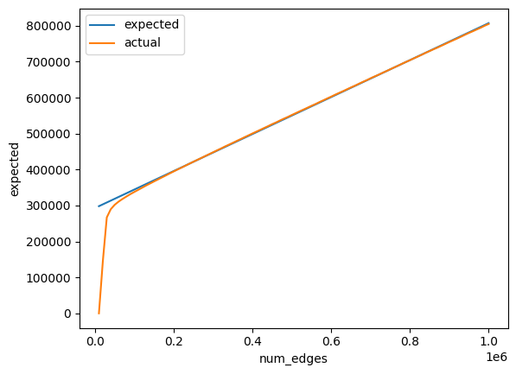
Empirical Analysis
Fixed Vertices Vary Edges
T(|V|, |E|) = k * |E| log |V| + C
k * |V| log |V|
|V| = 1e4
Regression on |E| > 1e5
k = 3.87104105e-02
Same reason as before,
When |V| is similar to |E|,
There is high chance for disconnected components to appear
Notes:
Similarly to obtain the equation for time complexity through our empirical result, we did linear regression. Note that since we are varying |E| now, we can consider the |V| log |V| part of the equation as a constant. And we obtained a constant k = 0.0387

Slide 18
Conclusion
Using linear regression we have proven that the time complexity is indeed O((|V|+|E|) log |V|)

Slide 19
Part C: Comparison of 2 Implementation
Time complexity of part a dijkstra: O(|V|²)
Time complexity of part b dijkstra: O((|V|+|E|) log |V|)
When |E| is small, (like social networks, web page connectivity)
(|V| + |E|) log |V| << |V|²
(so part b, list + min Heap is better)
When |E| is large, and it can at most be |V|², (like mesh network)
O((|V|+|E|) log |V|) ≈ O(|V|² log |V|) > O(|V|²)
(so part a, matrix + array is better)

Slide 20
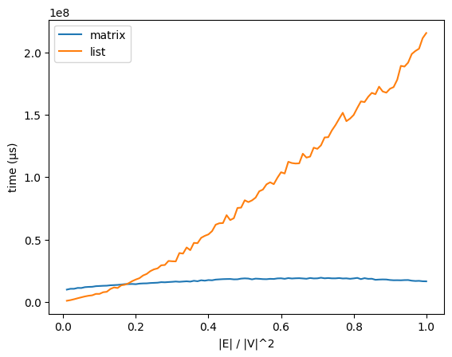
Part C: Comparison of 2 Implementation

Slide 21
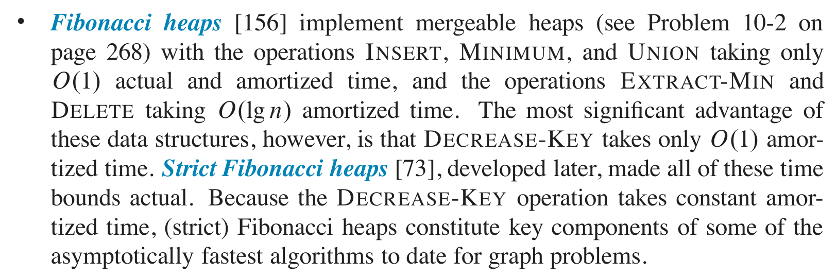
Fibonacci heaps
(Introduction to Algorithm, 4th)
Every update is a Decrease-Key operation, takes O(1) time (amortized)
So the time complexity takes O(|E| + |V| log |V|) time.
Notes:
Finally, we also studied the Fibonacci heap, an algorithm mentioned in the Introduction to Algorithms. Due to time constraints, we won't go into detail. After amortized analysis, its Decrease-Key operation can achieve O(1), reducing the overall complexity to O(|E| + |V| log |V|).

